Slide 1
Sustainable Management and Development for the Okavango Delta: Uplifting Angola, Uplifting the Delta
Country Represented: Angola
Amber Gray ASU, Bethany Peacock ASU, Tshephang ORI,
Clover McDougall ASU, Ebony Fisher UNSW, and Sarah Bassett UNSW
Date July 6th 2025

Slide 2
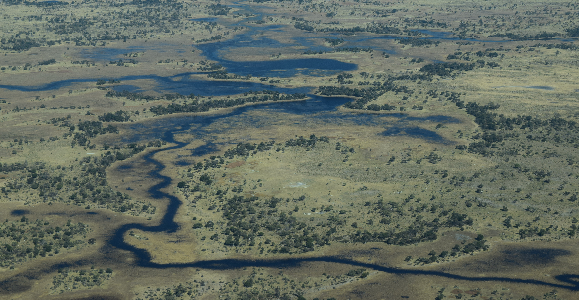
Introduction to the Okavango Delta

Slide 3
Introduction to the Okavango Delta
Endorheic system (does not drain to the ocean)
Most water comes from Angola
Cubango and Cuito rivers
Home to some of the most endangered animals
Mammals: elephants
Birds: Wattled crane

Slide 4
Country Context: Angola
Climate: tropical/sub tropical with wet and dry seasons
Geography: arid coastal, interior wet highland, interior savannah, northern rain forest
Population: 16 million (2008)
Capital: Luanda, pop. 8.3 million (2020)
Government: Republic
Exports: crude oil, diamonds, refined petroleum products, coffee (2007)
Imports: machinery, vehicles, medicine (2007)
History:
Portugal explorers arrived in Angola in 1482
Revolutionary struggle from 1961-1974
Gained independence November 11, 1975
Civil war until 2002

Slide 5
Sustainable Management and Development for the Okavango Delta
Uplifting Angola, Uplifting the Delta: Aligning the development needs of Angola with the ecological management of the Okavango by 2050 for people and planet

Slide 6
Proposed Sustainable Development Strategy
Equitable Reinvestment of Tourism Revenue into Angola
Sustainable Energy and Water Resources for All People of Angola
Support For Climate Smart Agriculture in Angola
Timeline 2025-2050

Slide 7
Ecological Impacts and Conservation Opportunities
Biodiversity conservation
sustainable watershed
Reforestation program
Available forage resources
Improved habitat available
Increased biodiversity
Establishing climate resilient infrastructure
Monitoring methods
Training local communities

Slide 8
Socioeconomic Impacts Assessment
Eco-tourism
Job creation
Economic diversification
Joint-infrastructure development
Climate financing

Slide 9
Stakeholder Identification & Analysis (governance)
Stakeholder | Interest | Influence | Engagement
Angolan Government | Angolan citizen wellbeing, economic growth, growing resources | High | Prioritise development and economic growth over sustainability
Botswana and Namibia govs | Maintaining water flows downstream | Low | Maintain strong relationships
OKACOM | Partner cooperation, Delta ecosystem health | Low | Holistic coordination body for Delta

Slide 10
Stakeholder Identification & Analysis (economic)
Stakeholder | Interest | Influence | Engagement
Tourism operators | Botswana and Namibia tourism | Medium | Incentivise water flow maintenance
Private sector (mining, oil, agriculture, hydroelectricity) | Accessing and managing natural resources for economic benefit | High | Receive incentives to operate sustainably
International aid investment | Funding for conservation & sustainable dev | High | Fund projects that benefit Angola

Slide 11
Stakeholder Identification & Analysis (social)
Stakeholder | Interest | Influence | Engagement
Angolan communities | Bear direct impacts of decisions | Low | Engage directly and bolster views for equality
Neighbouring Delta communities | Bear direct impacts of decisions | Low | Engage directly and bolster views for equality
Academia | M&E, scientific discovery, generating impact | Medium | Partnerships and collaborations, equity-focus
NGOs | Improving social outcomes while maintain ecological health | Medium | Advocate and action balanced development approach

Slide 12
Stakeholder Identification & Analysis
Strategy success relies on:
Transboundary collaboration through OKACOM
Creating long-term binding agreements
Sharing resources to uplift Angola to limit development pressure on Delta

Slide 13
Sustainable Management and Development Plan
Implementation for (proposed strategy)

Slide 14
Implementation of Sustainable Development Plan - Timeline
2025-2026: Proposal of Objective 1 – Reallocation of Tourism Revenue
- Key Stakeholders
Government
Tourism Companies
2030: Legislation Passes (Objective 1 achieved)
Established connections with overseas sustainable energy developers/government organizations (eastern powers)
Strengthen relationships with OKACOM for additional funding and support for future objectives
2030-2031: Implementation of Objective 2 – Eco-farming practices
Create education programs within the community
Build strong connection with local farmers/researchers/volunteers

Slide 15
Implementation of Sustainable Development Plan - Timeline
2030 - 2040: Implementation of Objective 3
Planning and development of sustainable energy sources: Solar and Wind
Importing resources
Begin Construction
2040: 100% of the energy grid is net 0 emissions
2040 – 2045: Eco-Friendly farming methods become common practice within 80% of farming communities; self-taught within the community
2050: Overarching vison and goals have been met and are sustainable

Slide 16
Roadblocks and Necessities
Political opposition
Materials and funds for sustainable energy and food production
Solar panels
Wind turbines
Fishery materials
Alliances in the east, particularly China

Slide 17
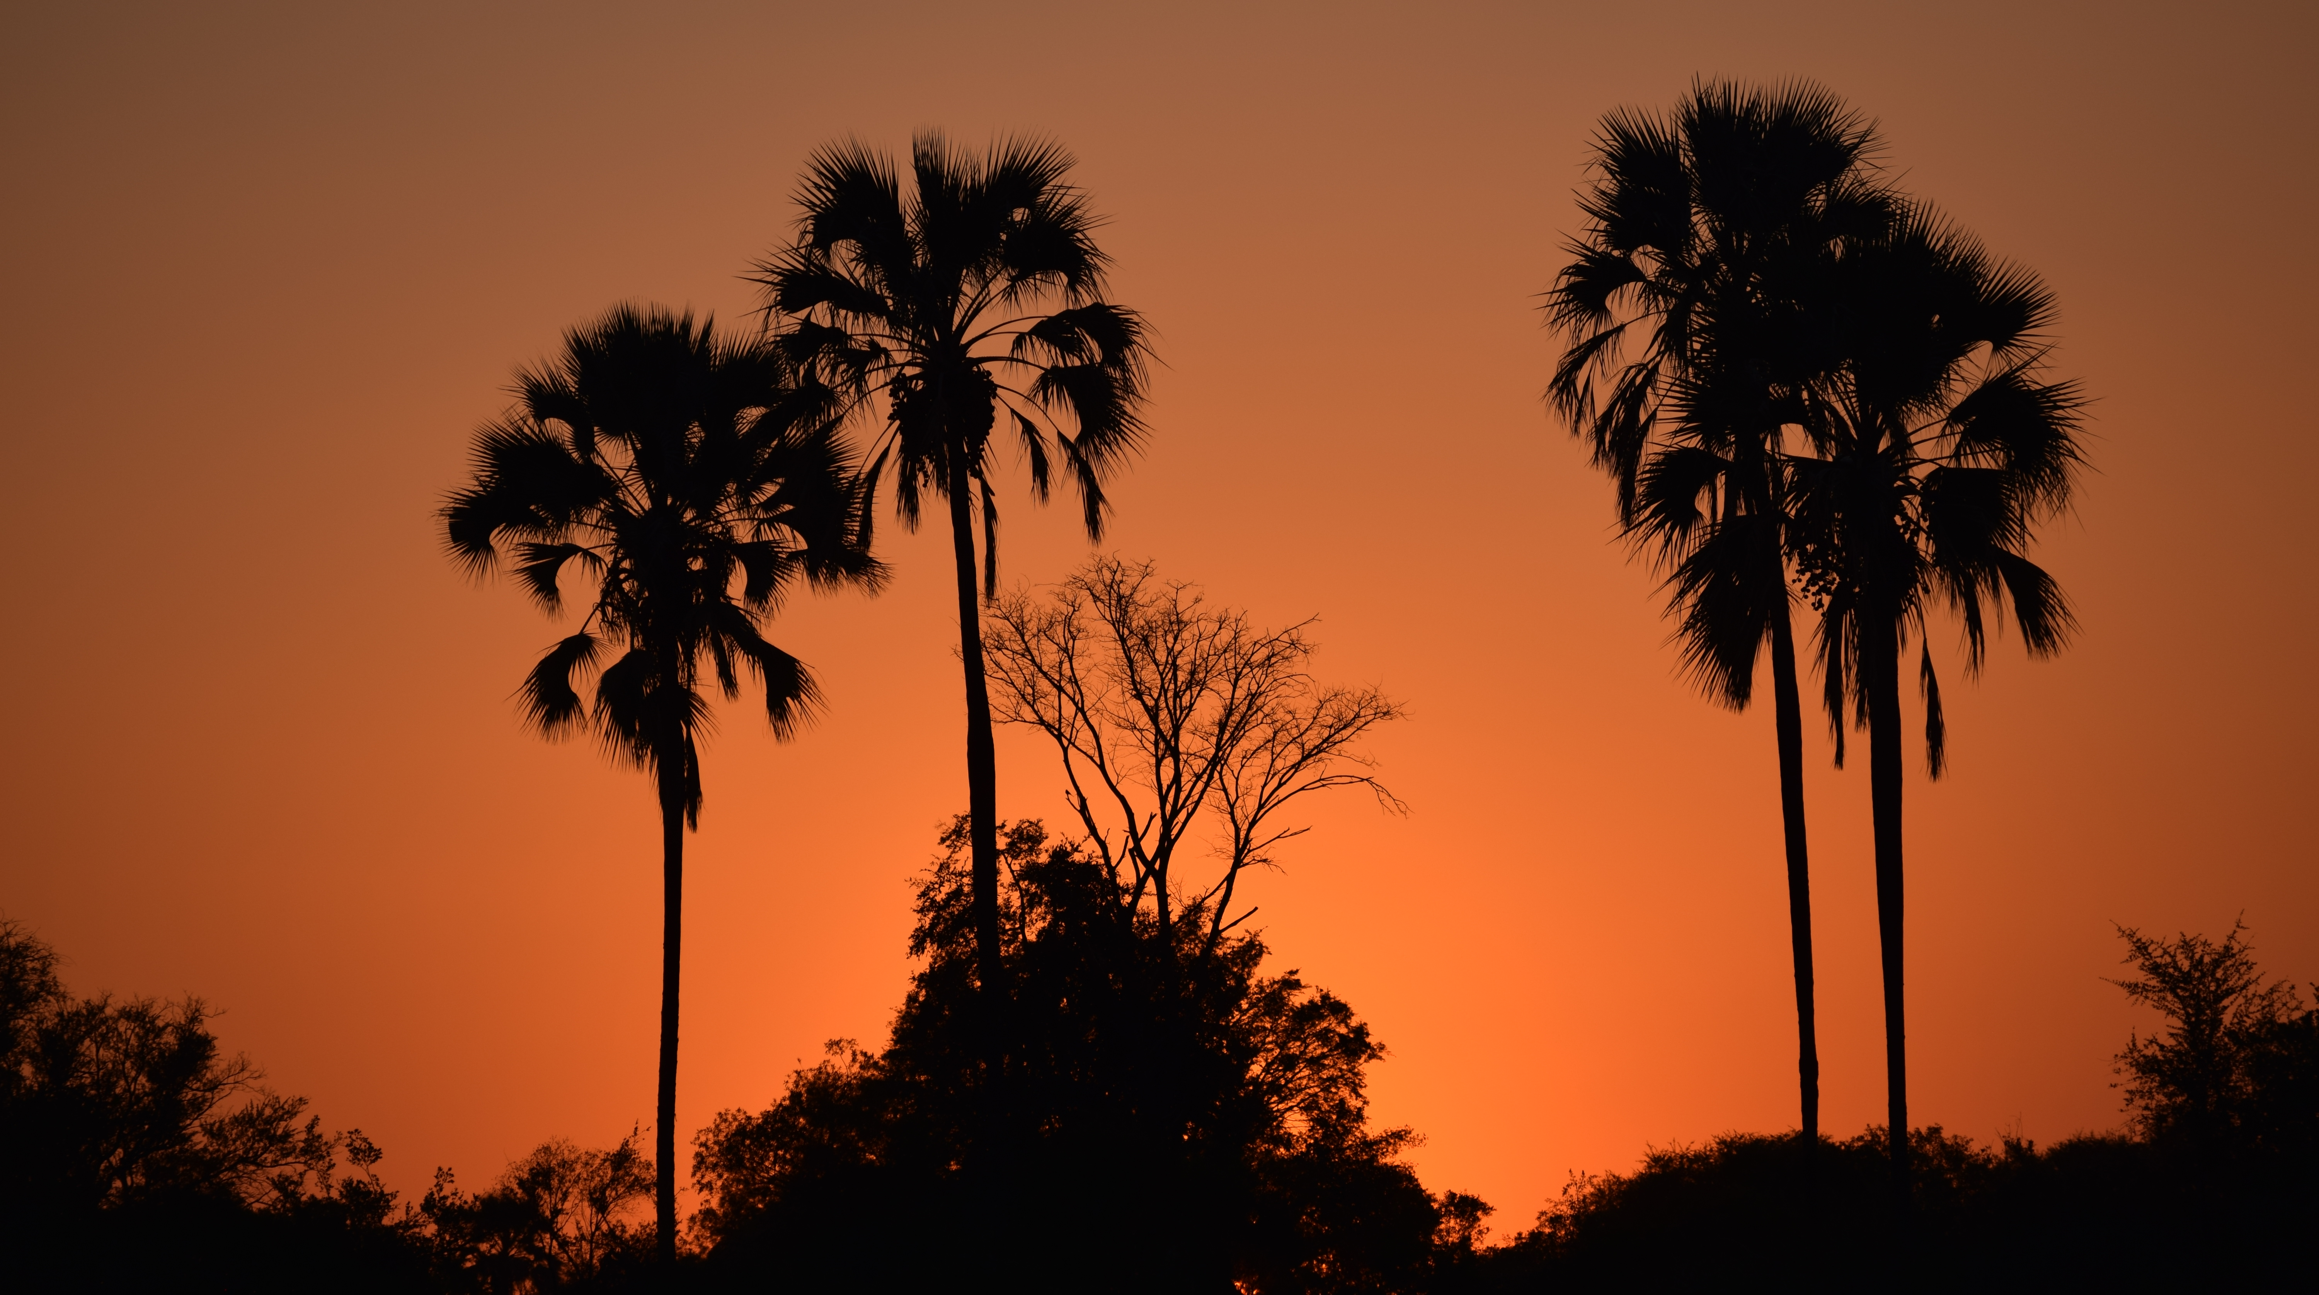
Conclusion and Recommendations

Slide 18
Conclusion and Recommendations
Summary of your final recommendations
Call to action

Slide 19
Stakeholder Question & Answers

Slide 20



Holding Page for Executive Summary / Presentation Overview
Tbc last once final content is agreed
Note: all formatting (including colours and font size) to be edited/reviewed once text is agreed

